Slide 1
Purdue business Analytics team
Meijer: Retail Real Estate Decision Support

Slide 2
AGENDA
Nearby Places Categories (Creation of the initial draft of master data-frame)
Sentiment Score on Yelp Reviews
Meijer Store Visits / Competitors Store Visits
Traffic Volume & Distance to Highway
Scoring Model Ideas
Questions / Next Steps

Slide 3
Nearby Places

Slide 4
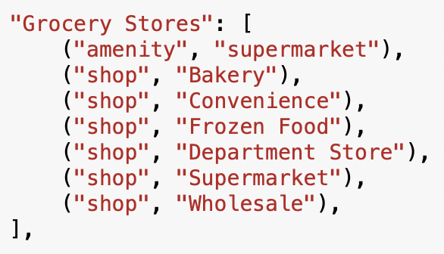
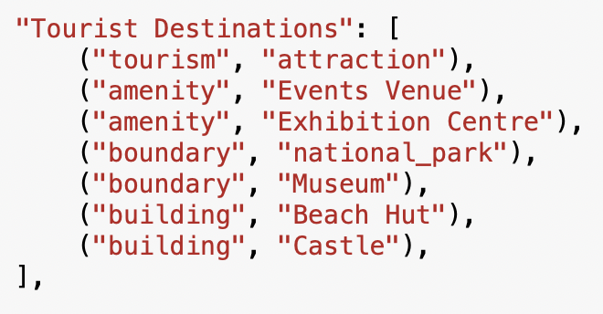
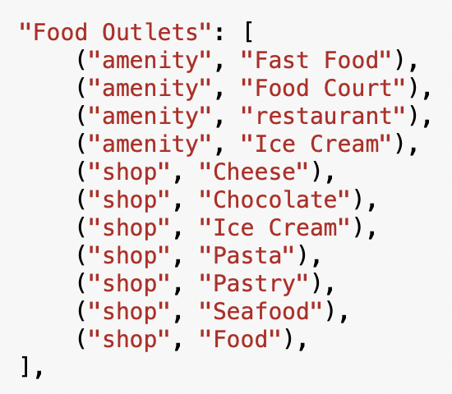
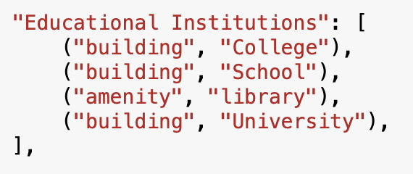
Nearby Places| Categories | Latitude & Longitude Level
1 mile

Slide 5
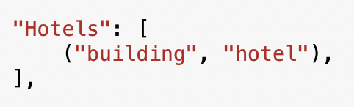
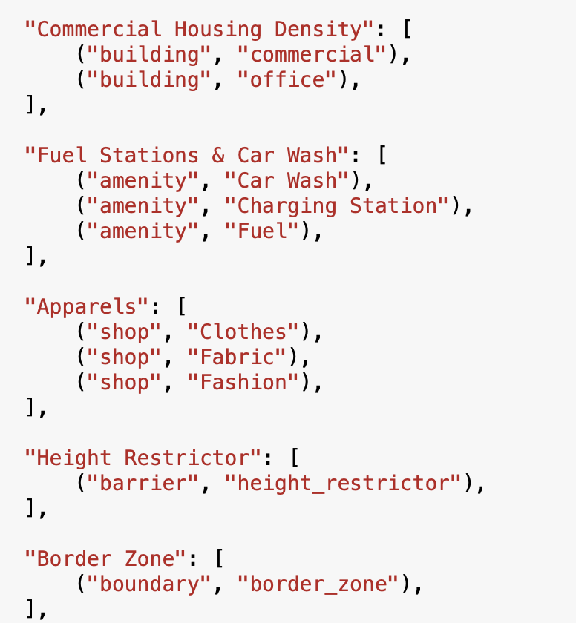
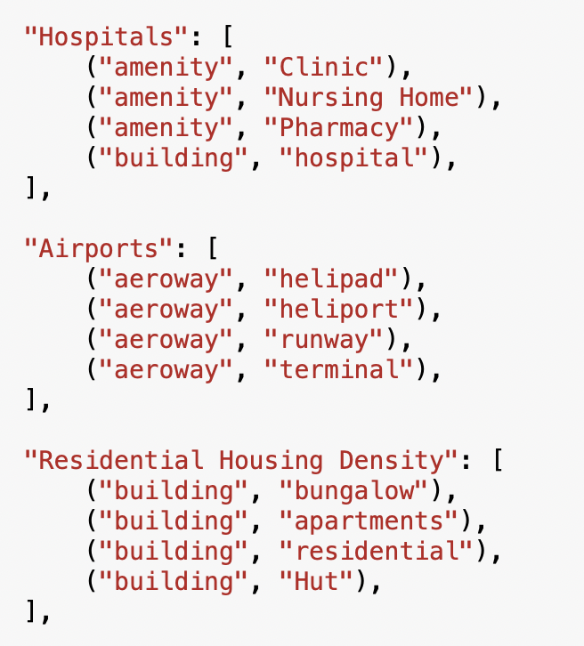
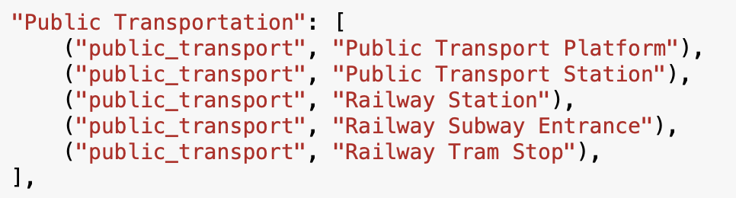
Nearby Places| Categories | Latitude & Longitude Level
1 mile

Slide 6
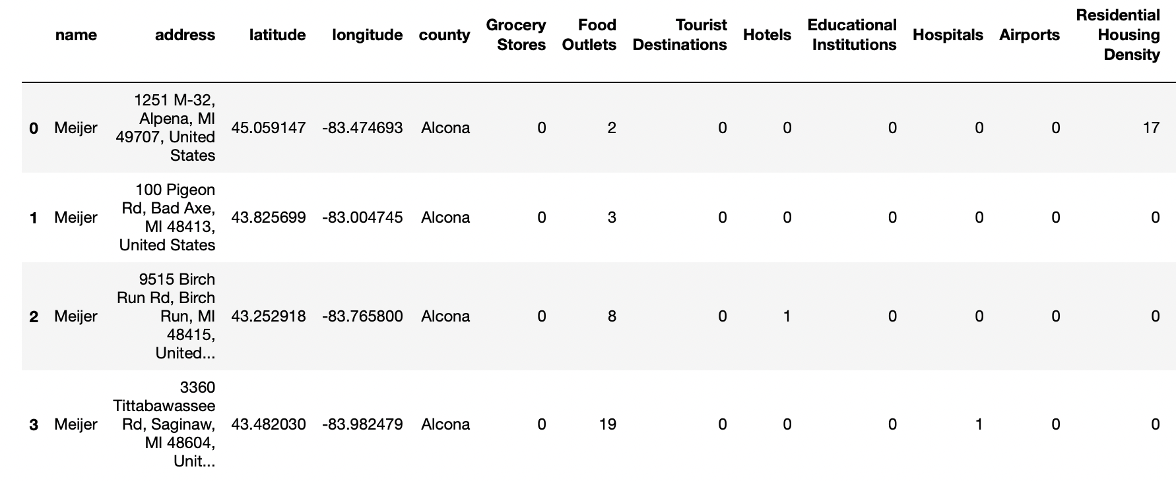
1 mile
Nearby Places| Categories | Latitude & Longitude Level

Slide 7
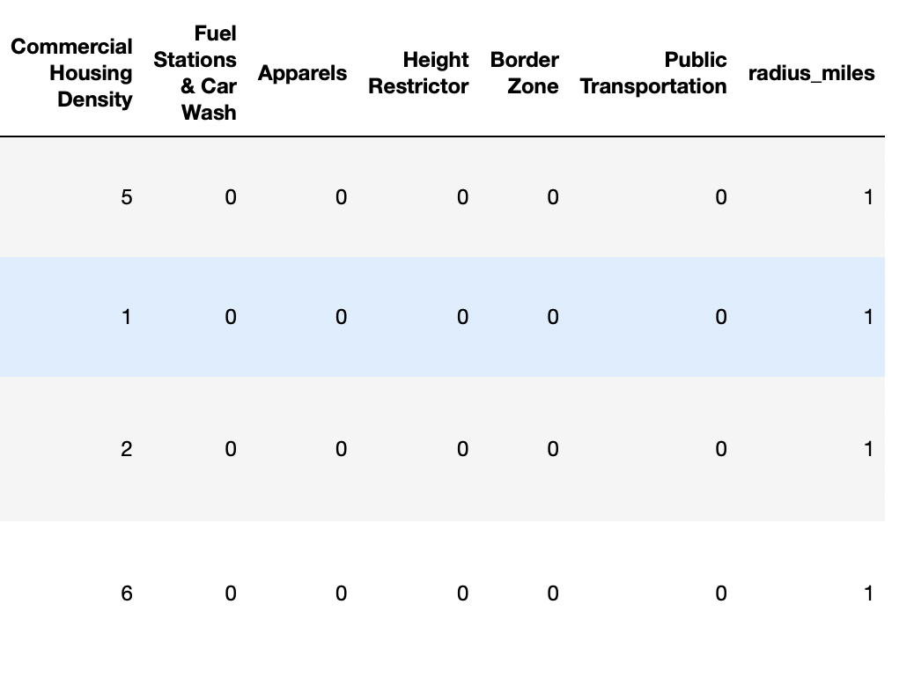
1 mile
Nearby Places| Categories | Latitude & Longitude Level

Slide 8
Sentiment Score on Yelp Reviews

Slide 9

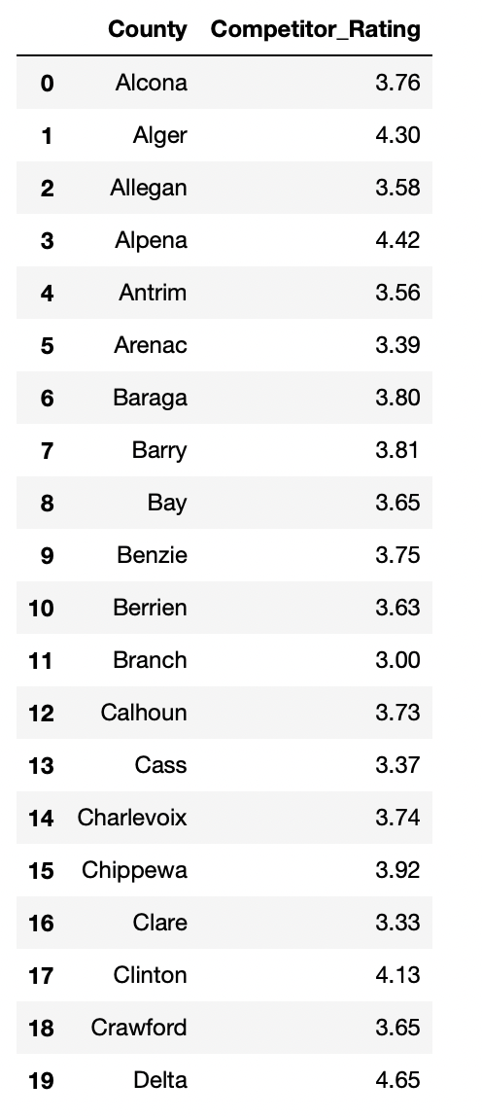

Competitor Rating | County Level
Rating per review
For all Top 10 supermarkets in all counties in Michigan
Average Rating per store
Average Rating per County
Competitor Rating

Slide 10

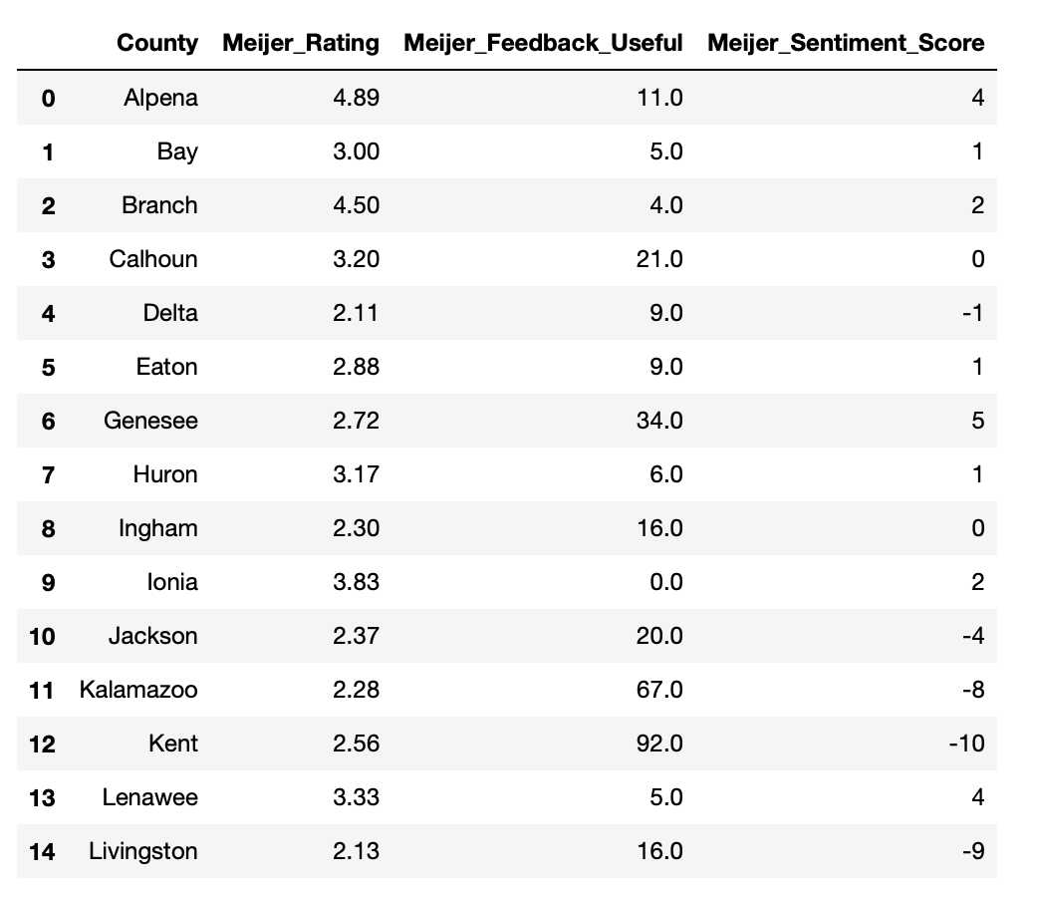
Meijer Metrics| County Level
Average Rating
Place Ids generated for each Meijer store in Michigan
Sentiment Scores
Positive = 1
Negative = -1
Mixed/Neutral = 0
Reviews scraped for each of these stores
Total Useful Feedbacks

Slide 11
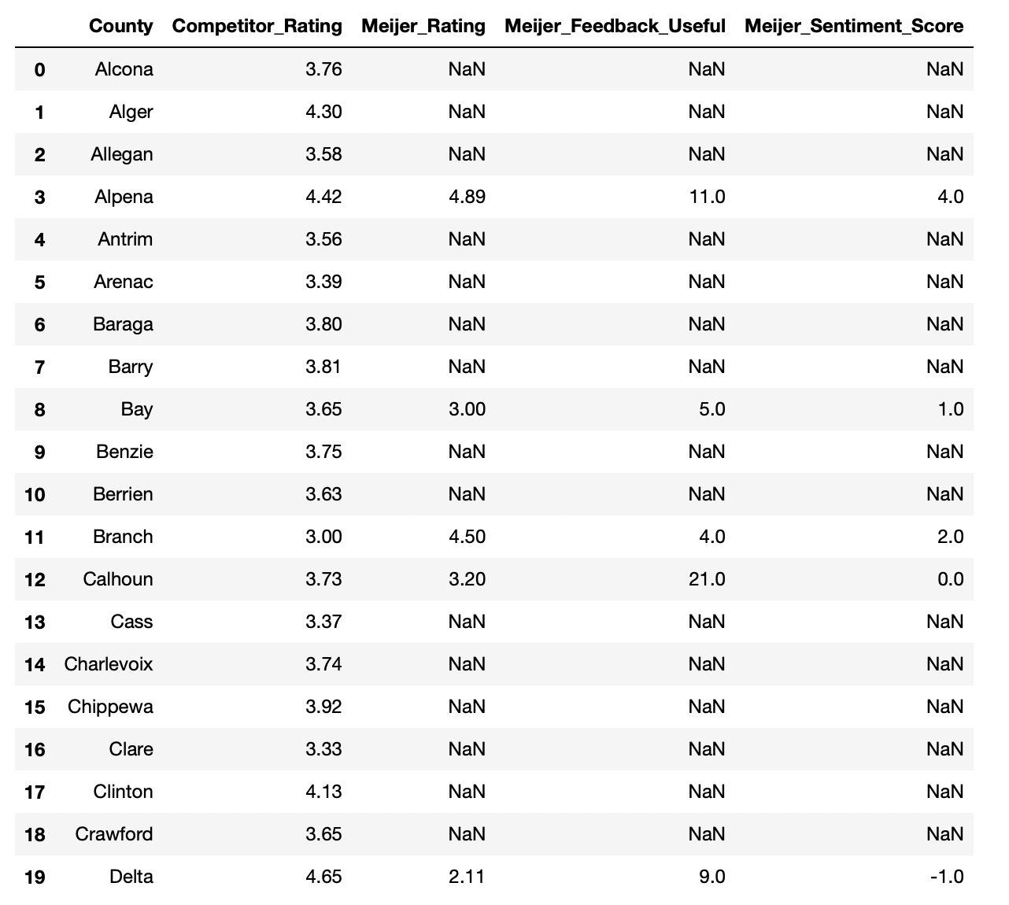
Final Sentiment Data-frame| County Level
Challenges
SerpAPI search query quota exhaustion:
Place IDs had to be generated manually for each store
Google Reviews Scrap consumes almost 40 search calls per store (There is a limit 100 free searches per month)

Slide 12
No. of visits

Slide 13



Store Visits| Foot Traffic | Store/Lat-Long Level
Competitors / Other Stores
OR

Slide 14
Traffic Volume & Distance to highway

Slide 15
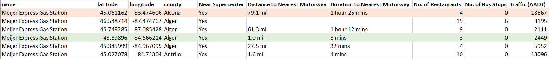
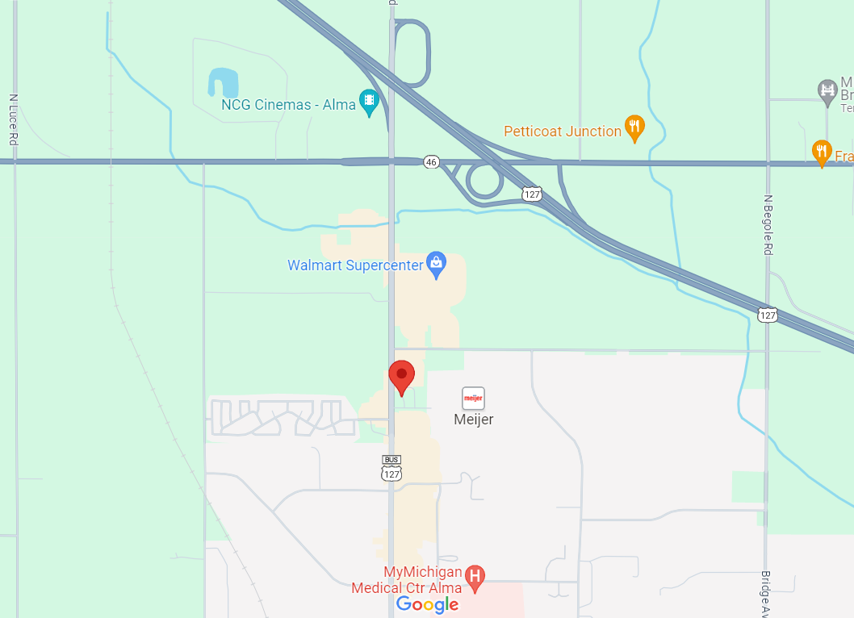
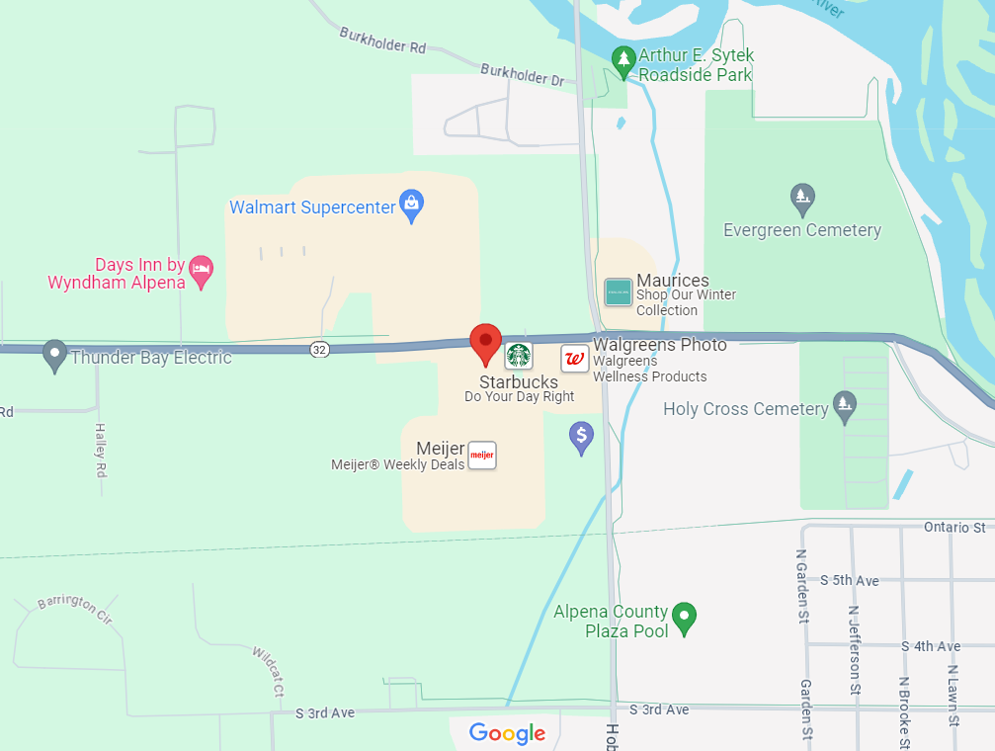
Traffic Volume + Distance to Highway
Alger
Alcona

Slide 16
Scoring Model Ideas

Slide 17
Idea #1: Scoring each parameter and Calculating Total Score
INPUT Variables
Assign variable importance to each parameter in the model.
At the County / Latitude Longitude Level, determine scoring ranges.
Each parameter contributes a percentage to the Total score.
Compare Scores of Existing Meijer stores, Competitors, and Potential Locations.
Target Variable
Traffic Volume
Distance to Highway
Nearby Places
Sentiment Score
Total Score
of a location
(Latitude & Longitude)

Slide 18
Idea #2: No. Of Visits as the Target Variable (Predictive Model)
INPUT Variables
Build a regression model using input variables without deciding the variable importance.
Let the model assign importance to each of the parameters based on coefficients.
Use the model to predict Number of visits
Compare number of visits for Existing Meijer stores, Competitors, and Potential Locations.
Target Variable
Traffic Volume
Distance to Highway
Nearby Places
Sentiment Score
Number of Visits
of a location
(Latitude & Longitude)

Slide 19
Questions/Next Steps

Slide 20
Questions / Next Steps
Questions
Will we be able to use Nielson’s data?
Confirmation on the target variable
Next Steps
Determine a scoring system for each of the factors
Explore other relevant features that would help in building the scoring algorithm

Slide 21
THANK YOU

